Slide 1

Monthly Update
October 16, 2019

Slide 2
Agenda
HL7 Connectathon in Atlanta
Official PACIO Projects at HL7
HL7 Timing for May 2020 Ballot
Connectathons

Slide 3
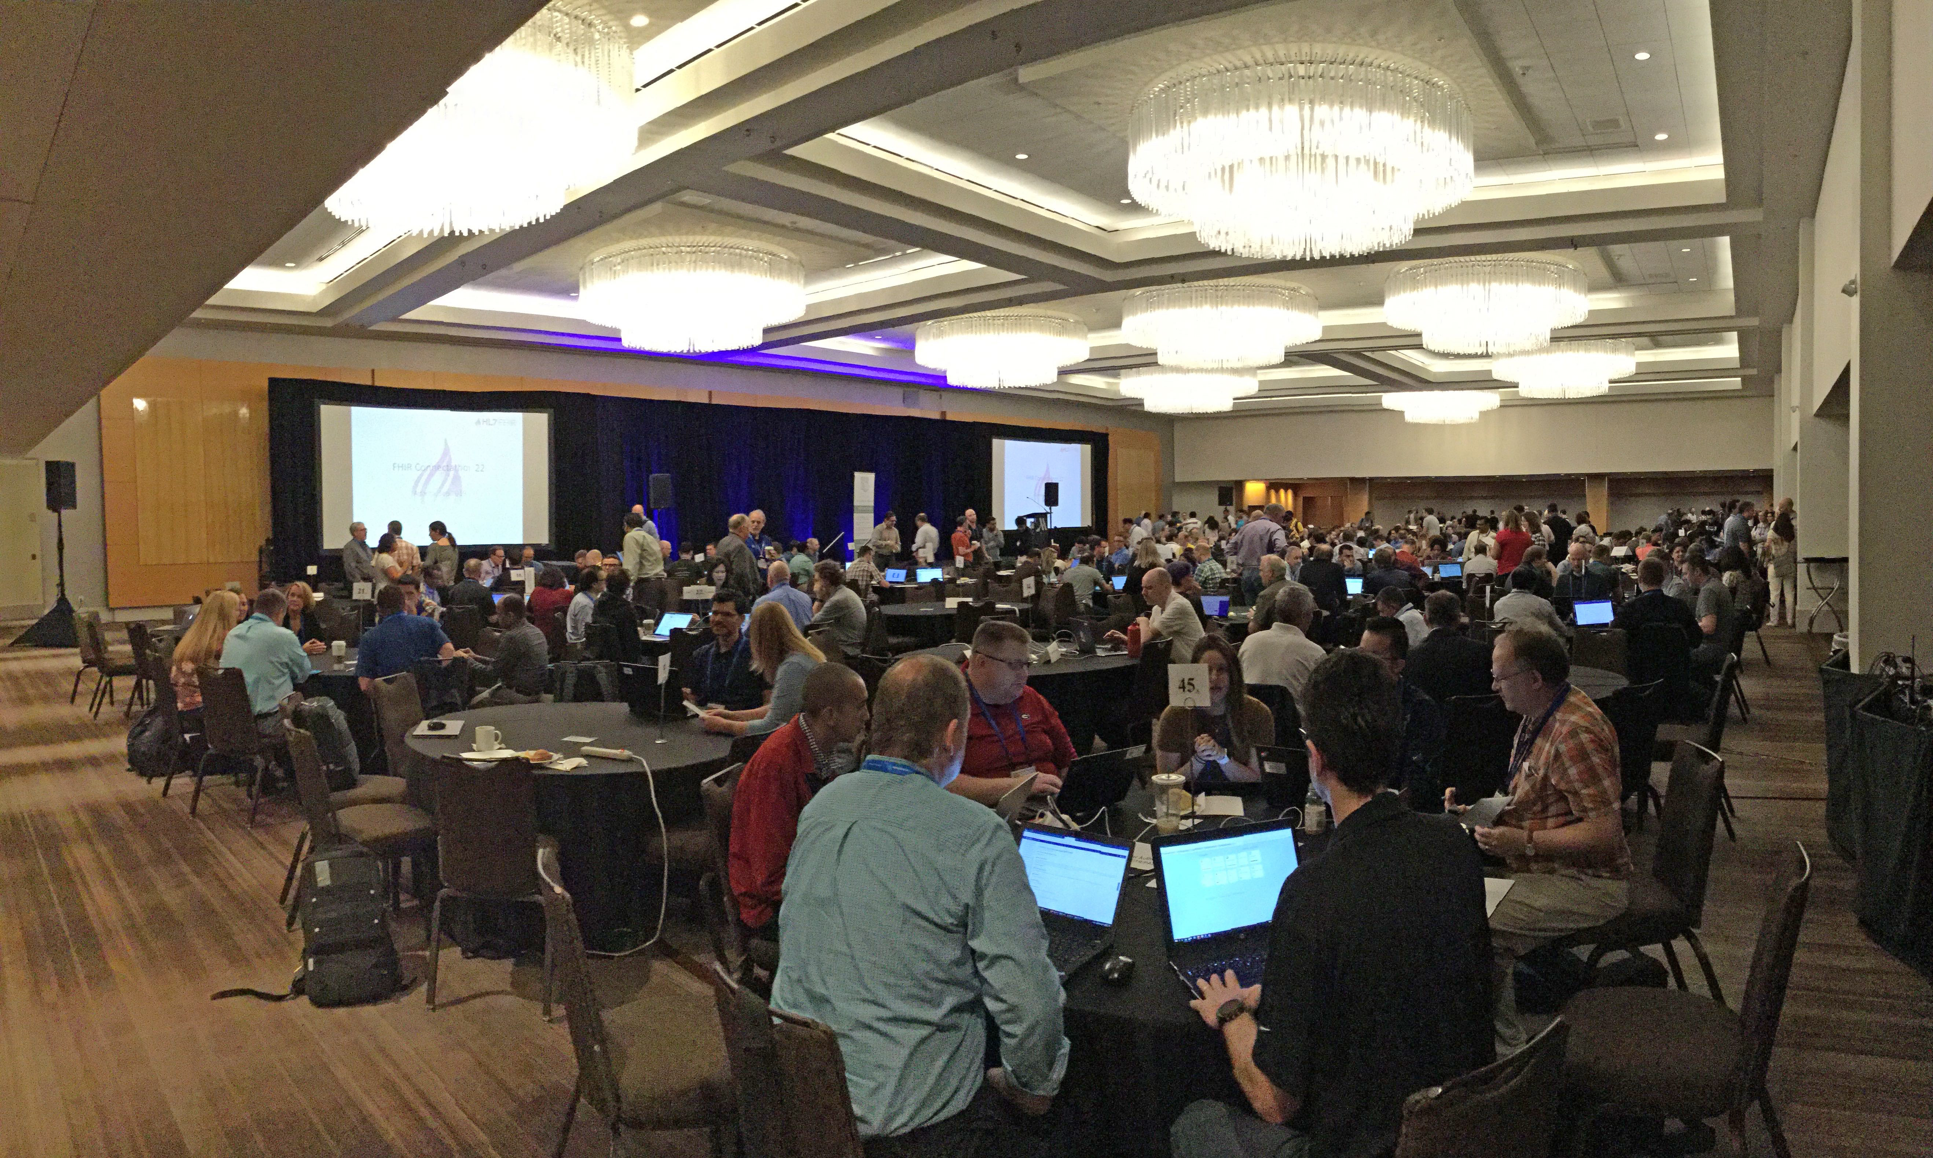
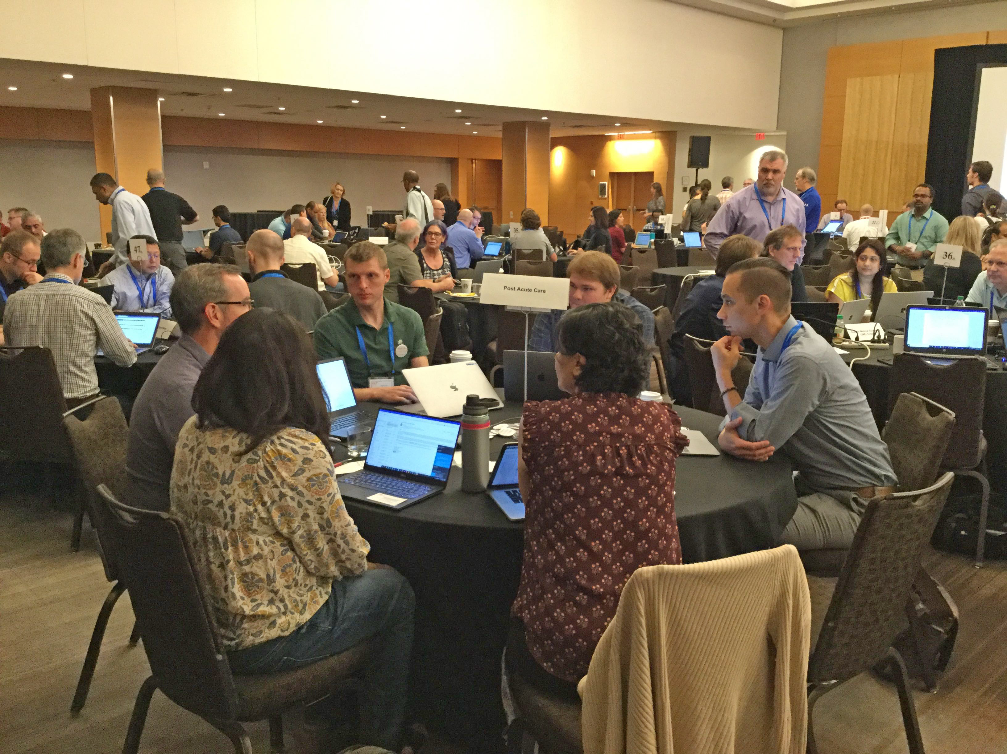
HL7 Connectathon in Atlanta
413 Attendees (previous high was 289)
39 Tracks

Slide 4
Official PACIO Projects at HL7
Functional Status Project Scope Statement
https://confluence.hl7.org/display/PC/PACIO+Project+Functional+Status
Cognitive Status Project Scope Statement
https://confluence.hl7.org/display/PC/PACIO+Project+Cognitive+Status
Both co-sponsored by:
HL7 Patient Care Work Group
HL7 Community-Based Care and Privacy Work Group
HL7 Patient Administration Work Group is an interested party

Slide 5
HL7 Timing for May 2020 Ballot Standard for Trial Use (STU1)
Oct 4, 2019
Project Scope Statement Due
Feb 16, 2020
FHIR IG Proposals Due
Mar 1, 2020
Notice of Intent to Ballot
Mar 13, 2020
FHIR Ballot Core Substantive Freeze
Mar 15, 2020
Initial Content Deadline
Mar 22, 2020
Reconciliation Deadline and Ballot Preview Period
Apr 5, 2020
Final Content Deadline
Apr 10, 2020
Ballot Readiness Sign Off
Apr 10-May 11, 2020
Ballot Open for Voting

Slide 6
Connectathons
January 7-8, 2020
CMS Connectathon (Baltimore)
Feb 2-3, 2020
HL7 February Connectathon (Sydney)
May 16-17, 2020
HL7 May Connectathon (San Antonio)

Slide 7
Patient Timeline
API Request
6/5/2019
Assessment
6/1/2019
Assessment
6/3/2019
Assessment
6/8/2019
Assessment
6/13/2019
Functional
Status
(Parent)
Functional Assessment 6/1/2019
(Child)
Functional Assessment 6/3/2019
(Child)

